Slide 1

AI-Powered Purple Teaming Playbook
Sean Wong
2025/08/05

Slide 2
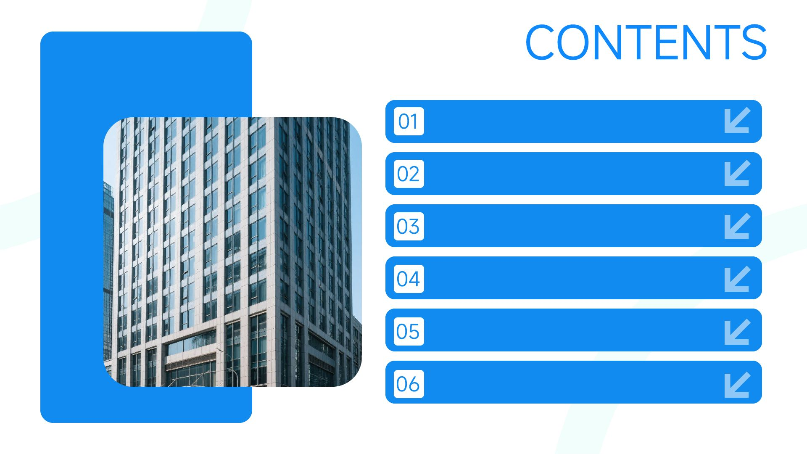
AI Suitability Matrix
Test Planning & Scenario Design
Red-Blue Correlation
Gap Analysis & Validation
Detection Engineering
Reporting & Collaboration

Slide 3

Knowledge & Roadmap
Implementation Strategy

Slide 4

01
AI Suitability Matrix

Slide 5

Mapping Purple Tasks to AI Potential
High and Medium AI Potential
Activities are categorized into high and medium AI potential based on how well they meet the criteria, guiding where AI can be most effectively applied.
Criteria for AI Suitability
Criteria include telemetry-heavy tasks, correlation-heavy processes, documentation-heavy activities, time-consuming efforts, ATT&CK mapping requirements, and collaborative interpretation needs.
Core Purple Teaming Activities
Nine core purple-teaming activities are identified, each evaluated for AI potential based on criteria like telemetry-heavy, correlation-heavy, and documentation-heavy tasks.

Slide 6

Criteria That Drive AI Adoption
Decisive Flags for AI
Guiding Prioritization
Telemetry floods, cross-source correlation, chronic reporting loads, manual ATT&CK mapping, and repetitive validation steps are identified as key flags driving AI adoption.
When three or more of these flags coincide, the task is flagged as high AI potential, guiding prioritization and budget decisions for purple teaming.

Slide 7
02
Test Planning & Scenario Design

Slide 8

Automated TTP Chains
Risk Impact Scoring
Tools like MITRE Caldera, PlexTrac, and AttackIQ AI automate the creation of TTP chains, significantly speeding up scenario generation.
AI engines assign ATT&CK IDs and score risk impact, ensuring scenarios are relevant and aligned with current threat intelligence.
AI Engines for Scenario Generation
AI helps define and enforce rules of engagement, keeping exercises within scope and reducing planner burnout.
What used to take days of manual planning can now be done in minutes, thanks to AI-driven scenario generation.
Scope Rules of Engagement
Efficiency Gains

Slide 9

Operationalizing AI Scenario Libraries
Living TTP Libraries
Feed threat-intel feeds into AI generators to produce living TTP libraries that evolve with emerging adversary behaviors, ensuring exercises remain relevant.

Slide 10
03
Red-Blue Correlation

Slide 11

Real-Time Action-to-Alert Mapping
Instant Alignment
Elastic AI, Chronicle AI, and Azure Sentinel AI instantly align red-team actions with blue-team alerts, producing side-by-side timelines.
Exposing Gaps
These tools expose missed detections within minutes, rather than hours, significantly improving detection efficacy.

Slide 12

Closing the Detection Gap Live
Highlighting Absent Alerts
Pushing Draft Queries
Immediate Feedback
AI highlights absent alerts and suggests on-the-fly rule tweaks, ensuring immediate improvements during exercises.
AI pushes draft SIEM queries to engineers before the exercise ends, converting drills into immediate detection uplift.
Real-time feedback allows for immediate adjustments, making purple drills more effective and actionable.

Slide 13
04
Gap Analysis & Validation

Slide 14

AI-Generated Coverage Heatmaps
Visual Coverage Gaps
Chronicle Coverage Dashboard, Splunk AI Insights, and Elastic Detection AI visualize ATT&CK techniques lacking rules, quantifying risk exposure.
Guiding Engineers
Ranking Gaps
These tools guide engineers to prioritize high-impact gaps, ensuring continuous improvement in detection coverage.
AI ranks gaps by threat prevalence, giving engineers a data-driven backlog for detection development.

Slide 15

Weekly Regression Simulations
SafeBreach AI and AttackIQ AI run weekly regression simulations, detecting rule drift and auto-filing tickets when coverage degrades.
Continuous Validation Pipelines
Ensuring Persistent Improvements
These pipelines ensure that purple-team improvements persist without manual re-testing, maintaining detection efficacy over time.

Slide 16
05
Detection Engineering

Slide 17

AI Drafts Detection Rules Instantly
Converting Red Behaviors
Suggesting Tuning
Splunk AI Assistant, Elastic Detections AI, and Chronicle Detection Assistant convert red-team behaviors into SIEM or EDR queries.
AI suggests tuning thresholds, significantly speeding up the rule creation process.
Reducing Time
Mapping to ATT&CK
AI maps these queries to ATT&CK technique IDs, ensuring alignment with industry standards.
What used to take hours can now be done in minutes, thanks to AI-driven detection rule drafting.

Slide 18

Redundant Rule Cleanup
Leaner Detection Sets
AI compares new drafts against existing rules, flags overlaps, proposes merges, and retires redundant rules, reducing noise and maintenance overhead.

Slide 19
06
Reporting & Collaboration

Slide 20

Auto-Generated Executive Reports
PlexTrac, Notion AI, and SOAR summarization engines convert technical findings into board-ready briefs, complete with ATT&CK charts and risk scores.
AI generates prioritized recommendations, ensuring that reports are actionable and relevant for leadership.
Report turnaround time is significantly reduced, from days to minutes, thanks to AI-driven summarization.
Technical to Executive
Prioritized Recommendations
Reducing Turnaround

Slide 21

AI-Augmented Team Communication
Translating Jargon
Enhancing Communication
General LLMs translate red-team jargon into blue-friendly language, facilitating better understanding and collaboration.
AI annotates dashboards with plain-English explanations and suggests discussion questions, bridging gaps and accelerating consensus.

Slide 22
07
Knowledge & Roadmap

Slide 23

Clustering Lessons Learned
Grouping Findings
Deduplicating Issues
Generating Roadmaps
Continuous Improvement
Confluence AI and PlexTrac Reporting Assistant group post-exercise findings by ATT&CK tactic, ensuring structured analysis.
AI deduplicates similar issues, reducing redundancy and improving focus on unique problems.
AI auto-generates a Top-10 improvement roadmap, ensuring that recurring weaknesses receive engineering attention first.
This approach ensures continuous improvement by prioritizing high-impact areas for future development.

Slide 24

Ensuring Ethical Use
Enforce human veto rights on AI-generated rules, maintain audit trails for model decisions, and validate outputs against ground-truth telemetry to prevent adversarial poisoning and ensure ethical AI adoption.
Ethical Guardrails for AI Adoption

Slide 25
08
Implementation Strategy

Slide 26

Phased Rollout Blueprint
Starting with High-Volume Tasks
Expanding to Real-Time Gap Analysis
Integrating Continuous Validation
Begin with high-volume, low-risk log correlation and scenario generation to establish a solid foundation.
Expand to real-time gap analysis and rule drafting once KPIs improve, ensuring continuous improvement.
Finally, integrate continuous validation and executive reporting after governance and trust mature.

Slide 27

Tracking Key Metrics
Track mean-time-to-map red actions to alerts, detection rule creation hours saved, coverage percentage increase, and report delivery time.
Measuring Purple AI Success
Informing Future Decisions
Feed deltas into quarterly reviews to justify wider AI adoption and pinpoint remaining bottlenecks requiring novel models or human creativity.

Slide 28

2025/08/05
Sean Wong

